Slide 1
Pivotal Cloud Foundry
Jan 2017

Slide 2
PCF -DAY 01

Slide 3

What Is Cloud?
Delivery of on-demand computing resources everything from applications to data centers over the Internet on a pay-for-use basis
Relies on sharing computing resources rather than having local servers or personal devices to handle applications
A cloud refers to a distinct IT environment that is designed for the purpose of remotely provisioning scalable and measured IT resources

Slide 4
Why Cloud?
Shared Resources
Dynamic Scaling
Pay as you Use
High Availability
High Productivity
Environment friendly
Less Deployment Time

Slide 5
Types of Cloud Computing
IAAS
PAAS
SAAS
Public
Private
Hybrid

Slide 6
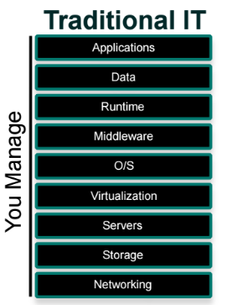
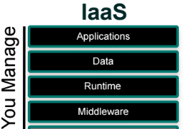

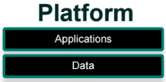
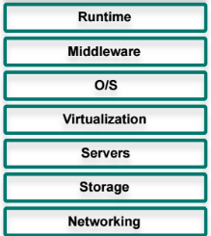

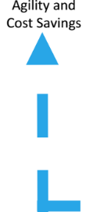
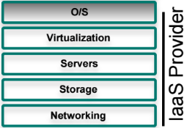
What is PaaS

Slide 7
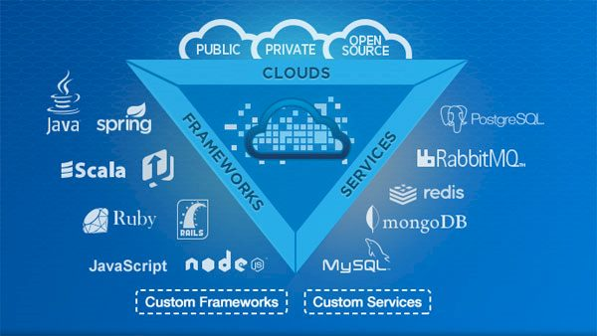
What is cloud Foundry
Cloud Foundry (CF) is an open source cloud platform and has become the industry standard on which developers can build,deploy run and scale applications on public and private cloud models.

Slide 8
Why Cloud Foundry
Open cloud platform[Reduce Vendor Lock in]
Meets developers needs
Compelling community
Public or Private
Language Independence
Wide growing Range of services

Slide 9
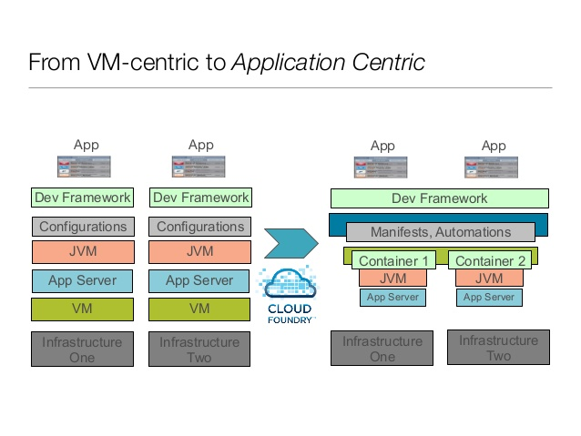
VM Centric to App Centric

Slide 10




CF Key Terminologies
Orgs
Top Most Organizational Unit.
It contains Users,Spaces and Domains
We mostly define routes, apps and services
Spaces
Every application and service is scoped to a space.
Each org contains at least one space.
Space provides users with access to a shared location for app development, deployment, and maintenance.
User Accounts
A user account represents an individual person within the context of a CF installation.
A user can have different roles in different spaces within an org, governing what level and type of access they have within that space.
Roles &Permissions
A user can have one or more roles.
The combination of these roles defines the user’s overall permissions in the org and within specific spaces in that org.

Slide 11
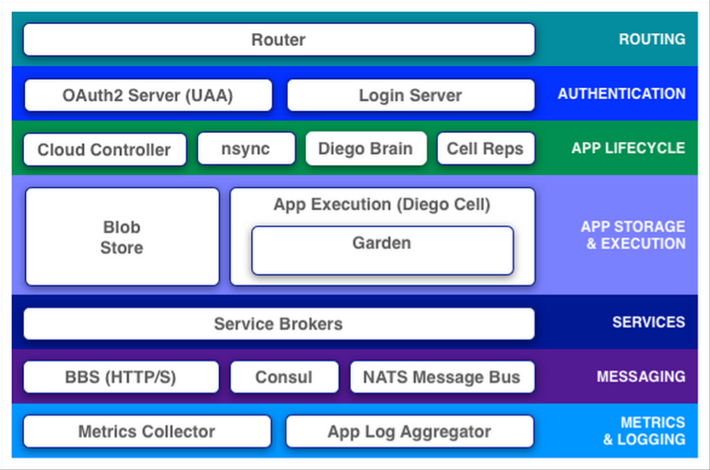
Cloud Foundry Components

Slide 12
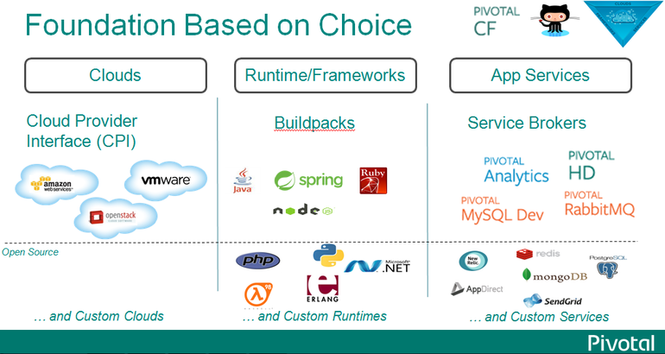
What is Pivotal CF

Slide 13
Pivotal Offerings
Public – Pivotal web services [run.pivotal.io]
Private – enterprise setup
Local – PCFDev

Slide 14
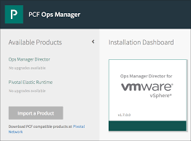
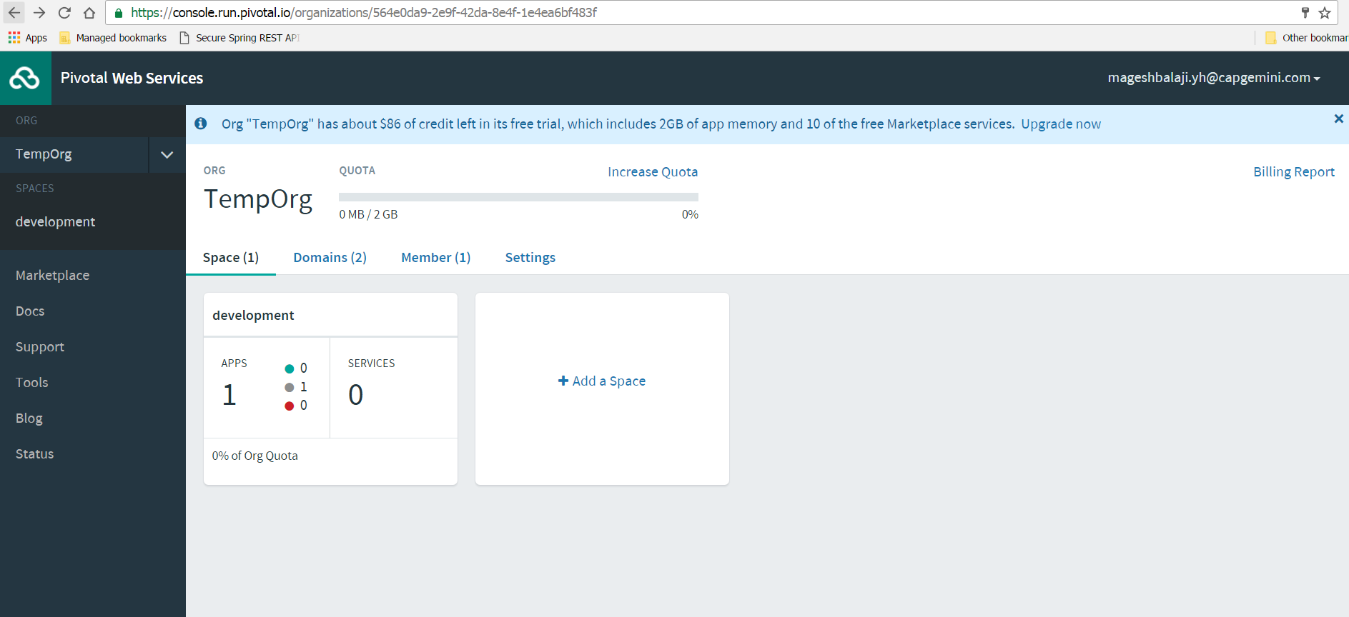
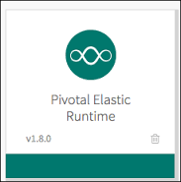
Pivotal CF

Slide 15
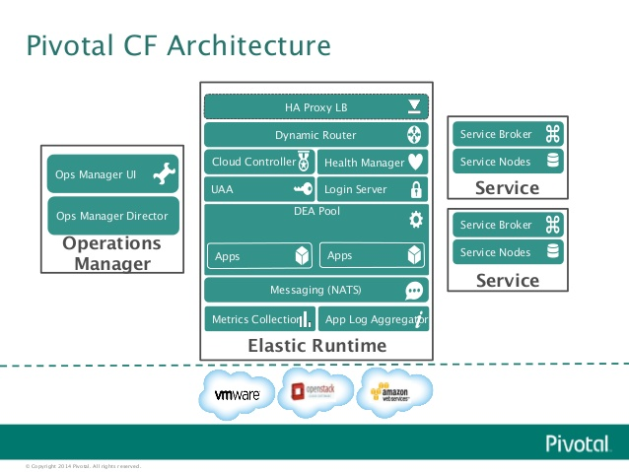
Pivotal CF Architecture

Slide 16
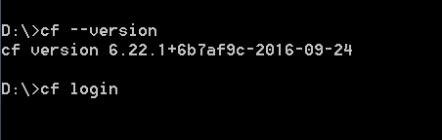
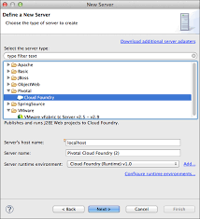
Interface Options
Command Line Interface
Web Console
Eclipse/STS Plugin

Slide 17
CF CLI commands
CF Help
E.g.
cf help
Use cf login to log in to Elastic Runtime.
E.g.
cf login [-a API_URL] [-u USERNAME] [-p PASSWORD] [-o ORG] [-s SPACE]
Commands for Listing Users:
E.g.
cf org-users
cf space-users
Command to Logout
E.g.
cf logout

Slide 18
CF CLI commands
List down apps
E.g. cf apps
To know the status of the app
E.g. cf app APP_NAME
The cf push command pushes a new app or syncs changes to an existing app.
Creating app my-awesome-app in org example-org
E.g. cf push my-awesome-app -b https://github.com/cloudfoundry/java-buildpack.git
The cf help command lists the cf CLI commands and a brief description of each.
E.g. cf delete –h
Commands for Managing Roles
E.g.
cf set-org-role (cf set-org-role huey@example.com example-org OrgManager)
cf unset-org-role
cf set-space-role
cf unset-space-role

Slide 19
Domains and URL
Every CF instance is assigned a domain while installation
When app is deployed it gets a unique route (URL) to access it
URL = HOSTNAME+DOMAIN
By default hostname is app name
Hostname should be unique

Slide 20
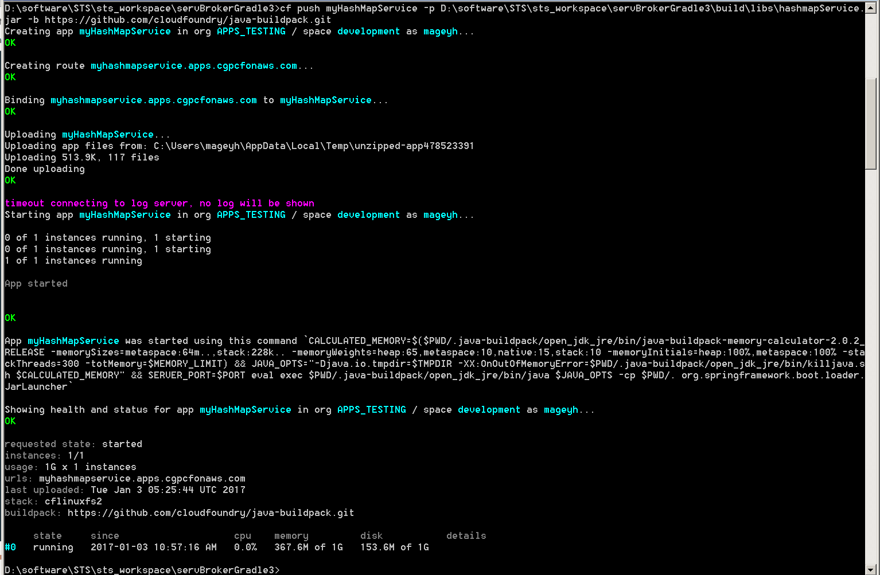
App Deployment through CLI

Slide 21
What Just Happened ?
Deployed an app to PCF by running a cf push command from the Cloud Foundry Command Line Interface (cf CLI).
E.g. cf push my-app –I 1 –m 512M –k 1G
The command does few operation at the background:
Uploads and stores app files
Examines and stores app metadata
Creates a “droplet” (the Cloud Foundry unit of execution) for the app
Selects an appropriate Diego cell to run the droplet
Starts the app
STAGING

Slide 22
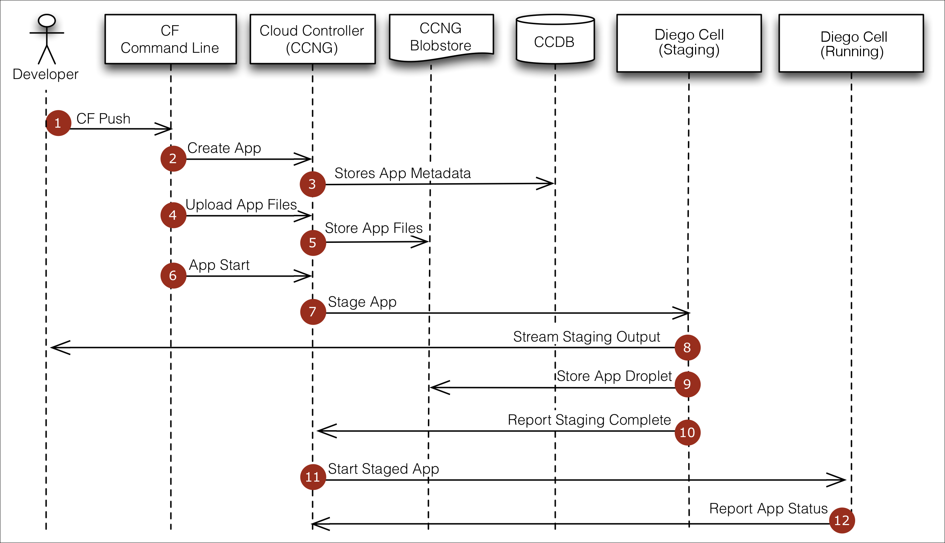
Staging!

Slide 23
Lab 01

